Slide 1
6-12 Math Forum
$\frac{1}{2}$ = .5
$\frac{1}{5}$ = .2
$\frac{1}{3x3}$ = .11
Try It!
What do you notice about these fractions that could help you determine if a fraction will produce a terminating
decimal or not?
Select other fractions
to test your pattern. Will it always work?
$\frac{1}{3}$ = .$3$
$\frac{1}{2x3}$ = .16
$\frac{1}{2x5}$ = .1
$\frac{1}{2x2}$ = .25
$\frac{1}{2x2x2}$ = .125
$\frac{3}{2x2x2}$ = .375
$\frac{3}{2x2}$ = .75
12/4/2012
Erin Wheeler
ewheeler@e2ccb.org
Erie 2 BOCES- IES

Slide 2
8:30-8:45 – Discussion of the 6-8 Testing Guides and PARCC Updates
Note the updated calculator policy
Resource Sheets and Required Tools- Protractor and ruler made available to have student choose the correct tool.
PARCC- Board of Regents wants a NY Common Core assessment so that they can have a choice between a NY test or PARCC when PARCC is developed.

Slide 3
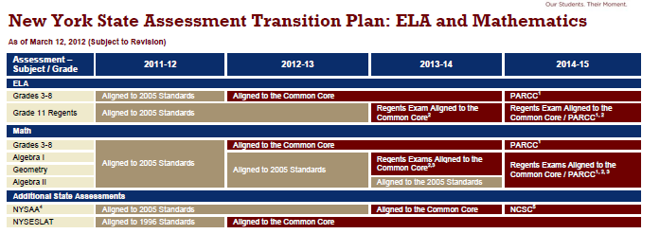
Assessment Timeline

Slide 4
Assessment Timeline
The PARCC assessments are scheduled to be operational in 2014-15 and are subject to adoption by the New York State Board of Regents. The PARCC assessments are still in development. All PARCC assessments will be aligned to the Common Core.
The PARCC consortium is developing ELA and mathematics assessments that will cover grades 3-11. New York State will continue to monitor the development of these assessments to determine how the PARCC assessments might intersect with the Regents Exams. Note that all new Regents Exams and PARCC assessments will be implemented starting with the end-of-year administration, rather than the winter or summer administrations.
The names of New York State’s Mathematics Regents Exams are expected to change to reflect the new alignment of these assessments to the Common Core. For additional information about the upper-level mathematics course sequence and related standards, see the “Traditional Pathway” section of Common Core Mathematics Appendix A (http://engageny.org/news/traditional-course-pathway-for-high-school-mathematics-courses-approved/).

Slide 5
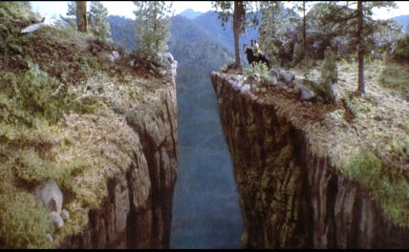
Increasing Complexity
Too Easy
“What’s
the point?”
Way Too Hard

Slide 6
Persevere in Solving Problems…

Slide 7
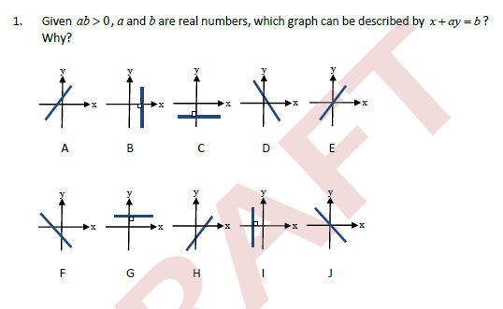
Problems With Teeth
What do you
Need to know and be able to do to solve the problem?

Slide 8
Make Use of Structure (MP 7)
Mathematically proficient students look closely to discern a pattern or structure.
They recognize the significance of an existing line in a geometric figure and can use the strategy of drawing an auxiliary line for solving problems.
They also can step back for an overview and shift perspective.
They can see complicated things, such as some algebraic expressions, as single objects or as being composed of several objects. For example, they can see 5 – 3(x – y)² as 5 minus a positive number times a square and use that to realize that its value cannot be more than 5 for any real numbers x and y.

Slide 9
Problems Without Figures
If you know three times plus five times plus seven times a number how do you find the number?
If you know the age of a boy and of his father, how can you find their combined ages a certain number of years from now?
A horse, rider and saddle weigh a certain number of pounds; the man weighs nineteen times as much as the saddle. If you are told what two-thirds of the horse’s weight is, how will you find the weight of the saddle?

Slide 10
Tape Diagrams
The ratio of Jim’s money to Peter’s money was 4:7 at first. After Jim spent ½ his money and Peter spent $60, Peter had twice as much money as Jim. How much money did Jim have at first?

Slide 11
Beyond a Tape Diagram
The ratio of Jill’s money and Kelly’s money was 4:5. After they each spent $156, the ratio became 8:11. How much money did Jill and Kelly have respectively, at first? (can’t draw)

Slide 12
Two kindergarteners participated in a fund raiser event “Walk Backwards for Hunger” last weekend. John walked 2/3 of a mile and Mary walked ¾ of a mile. Together, they raised $93.50. Please find out how much money John and Mary each raised. To be fair, the amount raised is proportional to distance walked.

