Slide 1
6-12 Math Forum
May 30, 2013
Tracey Simchick
Erin Wheeler
Erie 2 BOCES- IES

Slide 2
SED Updates
Regents Aligned to the Common Core
It is expected that the commencement-level math courses culminating in CCLS Regents Exams will be taught to most students in a sequential manner, beginning with Algebra I in the 2013-14 school year, followed by Geometry in 2014-15, and Algebra II in 2015-16.
* For the June 2014 and August 2014 administrations only, students receiving Algebra I (Common Core) instruction may, at local discretion, take the Regents Exam in Integrated Algebra (2005 Revised) in addition to the Regents Exam in Algebra I (Common Core) and may meet graduation requirements by passing either exam.
The last administrations of the current Regents Exams in Integrated Algebra, Geometry and Algebra 2/Trigonometry will be in January 2015, January 2016, and January 2017, respectively.

Slide 3
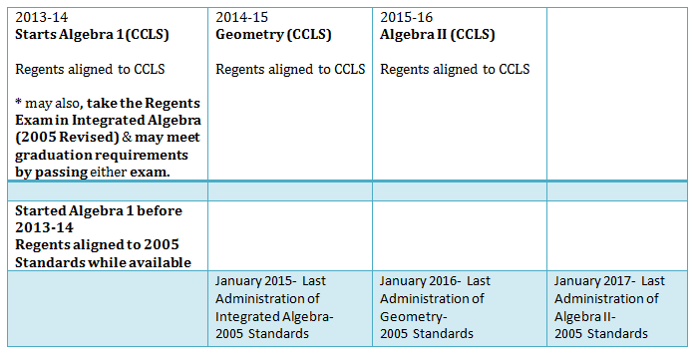

Slide 4
PARCC Updates
Universal Design for Learning
http://katienovakudl.com/even-the-parcc-does-udl/
http://parcconline.org/parcc-accessibility-accommodations-and-fairness
Proposed Accommodations
Assessment Policies-
Grade Specific Performance Level Descriptions- http://www.parcconline.org/math-plds
Administration Guides- http://www.parcconline.org/assessment-administration-guidance
Item Prototypes
Test Blueprints
Item Review Criteria

Slide 5
PARCC UPDATES
Explore one of the sites on slide 4
What is significant for teachers to note?
Enter your reflections on Today’s Meet http://todaysmeet.com/6-12mathforum
Name (District)
Reflection/Observation/Quote
Source Document

Slide 6
Module Development

