Slide 1
“A Story of Units”
Understanding the Structure of the Curriculum
7/17/2014
Erin Wheeler- Staff Development Specialist, Erie 2 BOCES

Slide 2
Textbook
What do you think when you hear the word “textbook?”
What has your relationship with textbooks been like over the years.
Notes:
Poll

Slide 3
A Different Vision of “Textbook”
Few U.S. textbooks paint mathematics as a dynamic, unfolding tale. They instead prioritize teaching procedures and employ a spiraling approach, in which topics are partially taught and then returned to—sometimes years later—with the unrealistic expectation that students will somehow connect the dots. But teaching procedures as skills without a rich context is ineffective. Students can too easily forget procedures and will fail if they do not have deeper, more concrete knowledge from which they can draw.
“How to Implement a Story of Units” page 4

Slide 4

“Knowing and Teaching Elementary Mathematics” Liping Ma
Interviews revealed that some teachers had a Profound Understanding of Fundamental Mathematics.
How do we develop this understanding?

Slide 5
A Different Vision of “Textbook”
“The textbook is the material on which Chinese teachers spend most of their time and devote most of their efforts to “study intensively.” They study it constantly throughout the school year when they teach it.
(Knowing and Teaching Elementary Mathematics, Ma (1999, pg. 132)

Slide 6
A Different Vision of “Textbook”
First of all, they work for an understanding of “what it is.” They study how it interprets and illustrates the ideas in the (Standards), why the authors structured the book in a certain way, what the connections among the contents are…
(Knowing and Teaching Elementary Mathematics, Ma (1999, pg. 132)

Slide 7
What is the goal of my math class?
To be able to solve a certain type of problems by the end of today.
To use the problems we are solving today to learn mathematics.
https://www.youtube.com/watch?v=B6UQcwzyE1U
(Phil Daro- Rationale of the Math Standards 5 min)

Slide 8



Textbooks that brings the world of elementary mathematics research into the classroom.
Elementary Mathematics Research
Elementary Mathematics Classrooms

Slide 9
A Trilogy of Mathematics
A Story of Units
PK-5
6-8
A Story of Ratios
A Story of Functions
9-12

Slide 10


A Misconception to Clear Up
http://commoncore.org/
http://www.corestandards.org/about-the-standards/

Slide 11
Focus in the Standards
K–2 | Addition and subtraction - concepts, skills, and problem solving and place value
3–5 | Multiplication and division of whole numbers and fractions – concepts, skills, and problem solving
6 | Ratios and proportional reasoning; early expressions and equations
7 | Ratios and proportional reasoning; arithmetic of rational numbers
8 | Linear algebra and linear functions

Slide 12
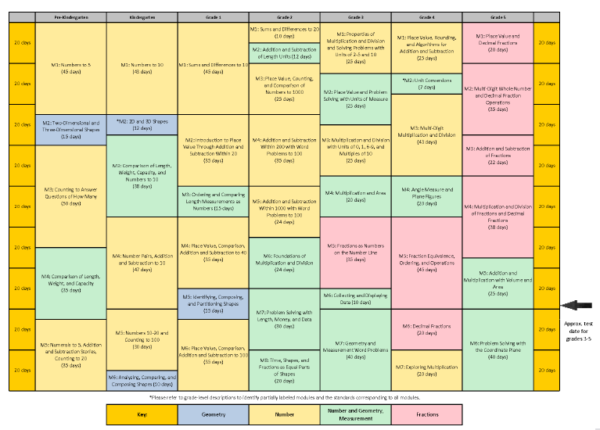
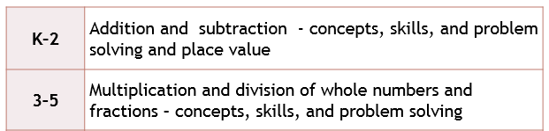
Curriculum Map and Overview
Interactive Curriculum Map- http://commoncore.org/maps/math/

Slide 13
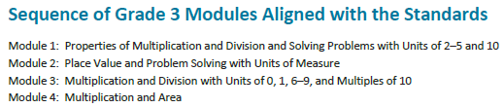
Curriculum Map and Overview
Interactive version- http://commoncore.org/maps/math/
NYS Test Guides https://www.engageny.org/resource/test-guides-for-english-language-arts-and-mathematics
Notes:
Module 2 provides an extra 25 days to build fluency around the multiplication and division with units of 2-5 and 10.
Note that module 6 is a post test module for grade 4. Consider the impact this module has to grade 5 being able to dive into their content.

Slide 14
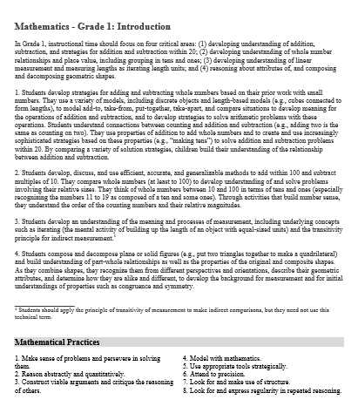
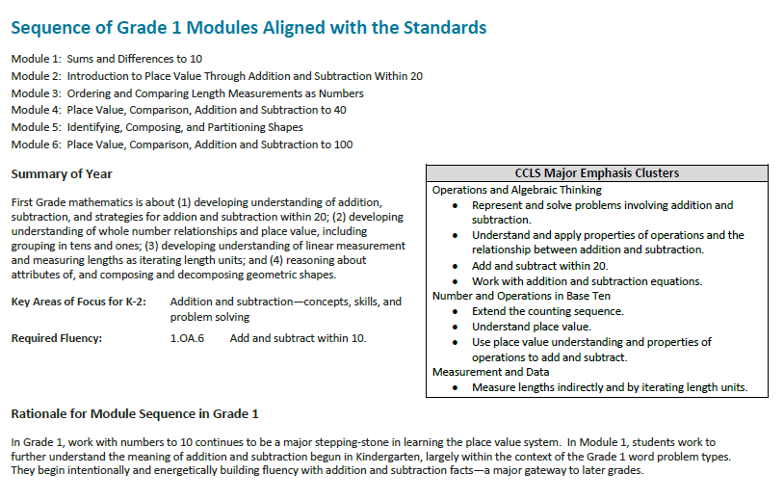
Going Beyond the Map
Notes:
Pg 16 is the start of the grade 1 overview.

Slide 15
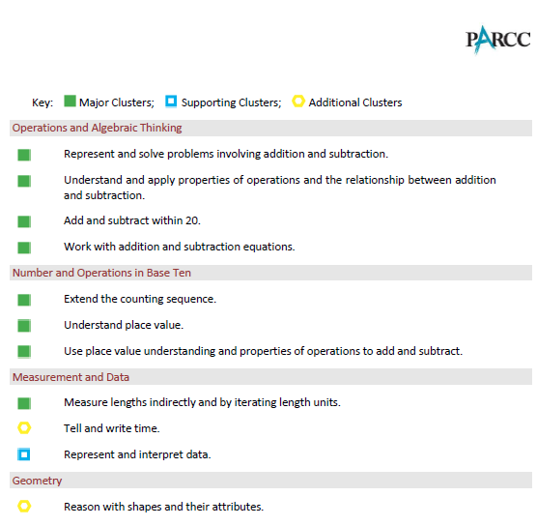
Going Beyond the Map
http://parcconline.org/sites/parcc/files/PARCCSampleItems_MATH-Literacy_Grade5ItemsFinal.pdf
http://parcconline.org/sites/parcc/files/PARCCMCFMathematicsNovember2012V3_FINAL_0.pdf
Notes:
Pg 16 is the start of the grade 1 overview.

Slide 16
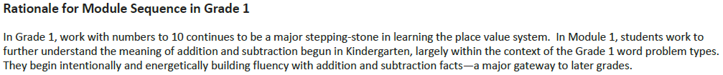
Going Beyond the Map
Notes:
Pg 16 is the start of the grade 1 overview.

Slide 17
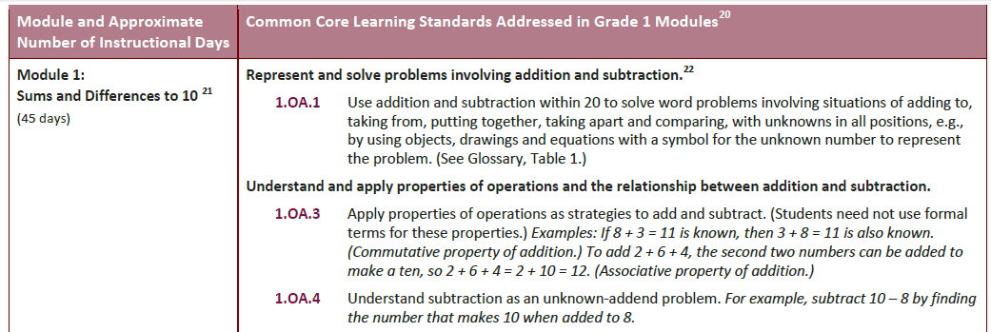

Going Beyond the Map

Slide 18
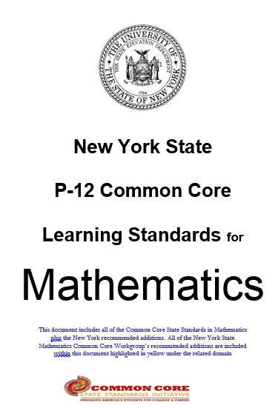
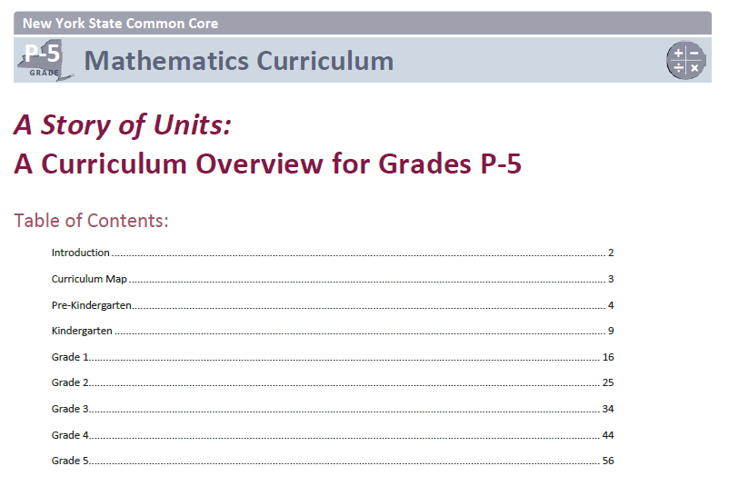

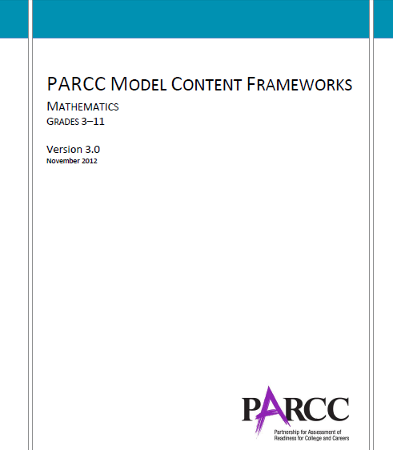
Creating the Curriculum Map

Slide 19
Grade Level Standards- What all students need to know and be able to do.
What we are able to assess through a standardized test.
Curriculum

Slide 20
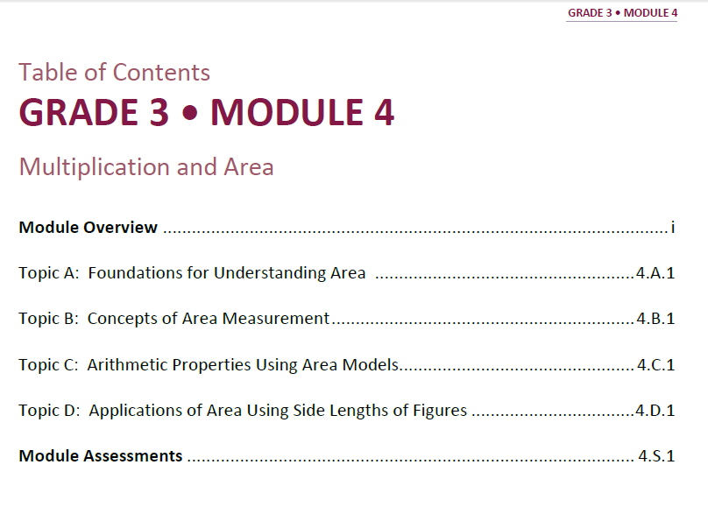
Notes:
The module overviews, topic openers (pages at the start of every topic before the first lesson in that topic), and assessments were submitted for approval before lesson writing could begin. This allowed the lesson design to begin with the end in mind.

Slide 21
Module Structure
Module Overview
Topic A
L1
Topic B
L4
Topic C
L5
L2
L3
L6
L7
L8
Notes:
TIME ALLOTTED FOR THIS SLIDE:
1 minute
MATERIALS NEEDED:
X

Slide 22
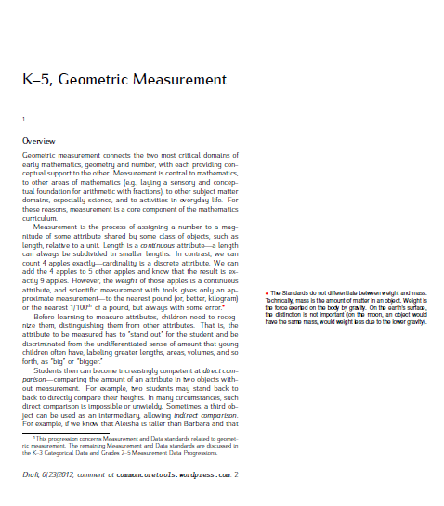
Progressions Documents
“…explain why standards are sequenced the way they are, point out cognitive difficulties and pedagogical solutions, and give more detail on particularly knotty areas of the mathematics. This would be useful in teacher preparation and professional development, organizing curriculum, and writing textbooks.”
http://ime.math.arizona.edu/progressions/

Slide 23
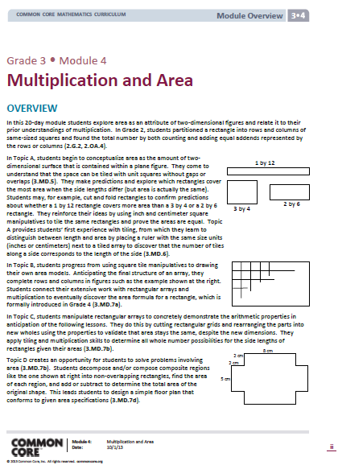
Overview Narrative
Explains the sequence outlined on the title page.
Helps you see where we’ve been and where we’re going.

Slide 24
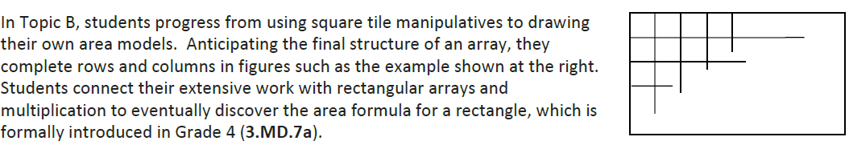
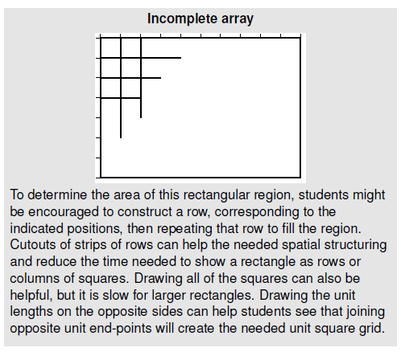
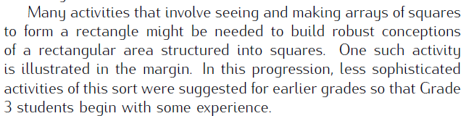
This seems strange…
http://ime.math.arizona.edu/progressions/

Slide 25
Module Structure
Module Overview
Topic A
L1
Topic B
L4
Topic C
L5
L2
L3
L6
L7
L8
Simple Complex
Notes:
For those of you who may be unfamiliar with A Story of Units, I’ll take just a moment to review the organizational structure of the modules that make up A Story of Units:
Each grade contains 5-8 modules. Modules are comprised of topics, topics break into concepts, and concepts become lessons. Modules and topics will vary in length depending on the concepts addressed in each. In 1st through 5th grades, every lesson is designed for a 60 minute instructional period; in Kindergarten, lessons are designed for a 50 minute period; Pre-kindergarten lessons are designed for a 25 minute period.
This graphic illustrates the breakdown of the module structure. Each component, moving from the Overview to the Lesson, provides a more specific level of information. As you plan to implement A Story of Units, each of these components will be important to your understanding of the instructional path of the module.
The Standards, both Content and Practice, come to life through the lessons. Rigorous problems are embedded throughout the module. We will spend time in the upcoming sessions exploring this further.
TIME ALLOTTED FOR THIS SLIDE:
1 minute
MATERIALS NEEDED:
X

Slide 26
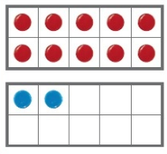
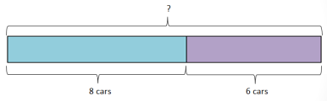

Making the Connections
Concrete
Pictorial
Abstract
9 + 6 = 15
Notes:
As students work on solving problems, it important to make an intentional connection from the concrete, to the pictorial, to the abstract. Students need concrete models when building number sense, but as they develop their understanding it is important that they transition to more efficient modeling tools.

Slide 27
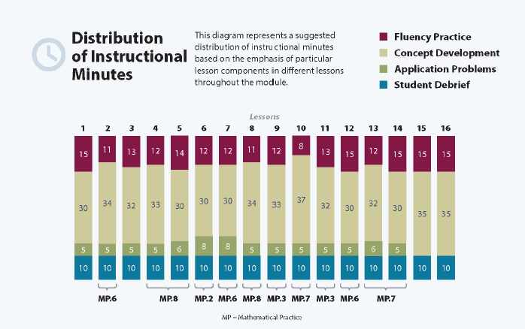
Resources with the Overview

Slide 28
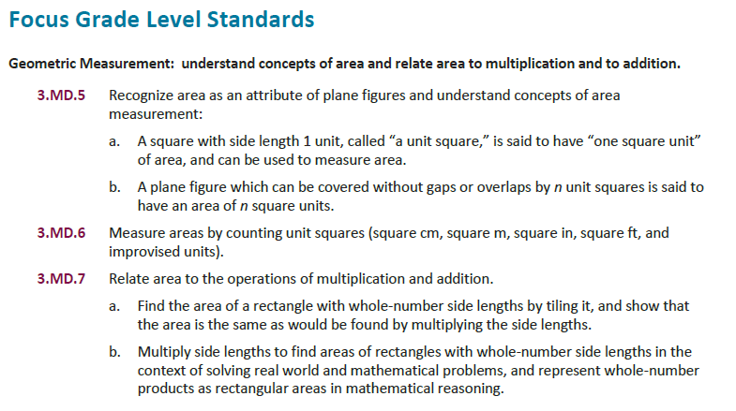

Slide 29
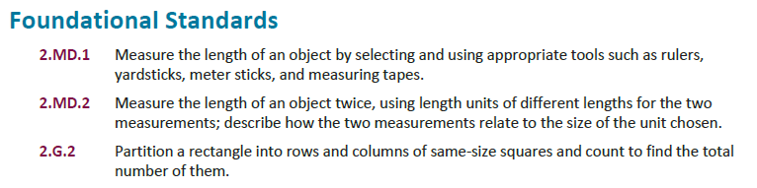

Slide 30
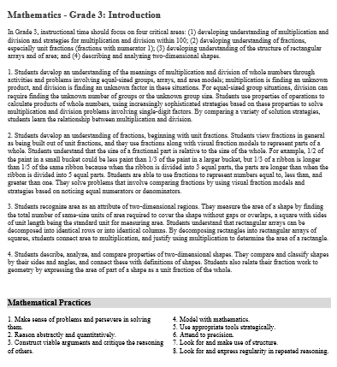
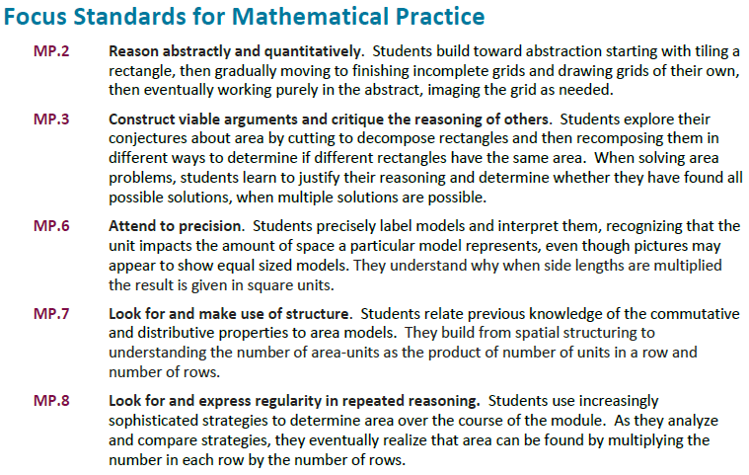

Slide 31
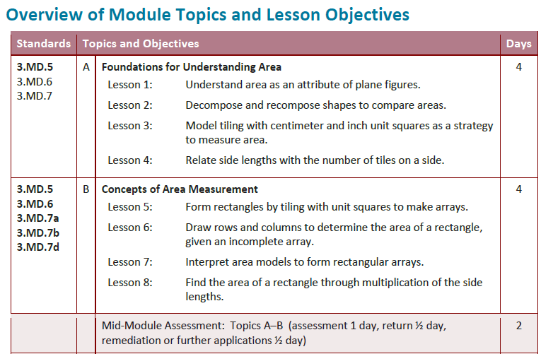
Put a sticky note to remind you!

Slide 32
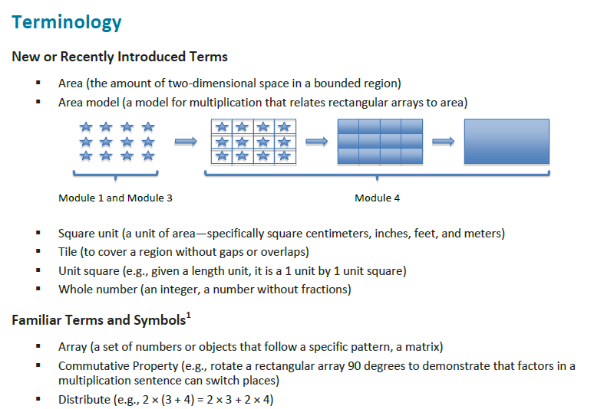
1st occurrence in bold; often introduced in the debrief

Slide 33
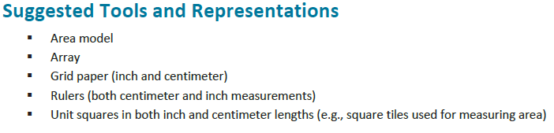
“How to Implement a Story of Units” Mathematical Models pages 26-45 https://www.engageny.org/resource/pre-kindergarten-grade-5-mathematics-curriculum-map-and-guiding-documents

Slide 34
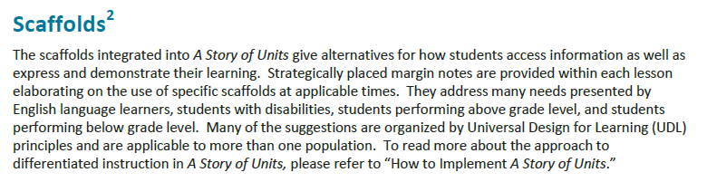
Multiple Means of Representation
Multiple Means of Action and Expression
Multiple Means of Engagement
“How to Implement a Story of Units” Differentiating Instruction pages 14-20 https://www.engageny.org/resource/pre-kindergarten-grade-5-mathematics-curriculum-map-and-guiding-documents

Slide 35
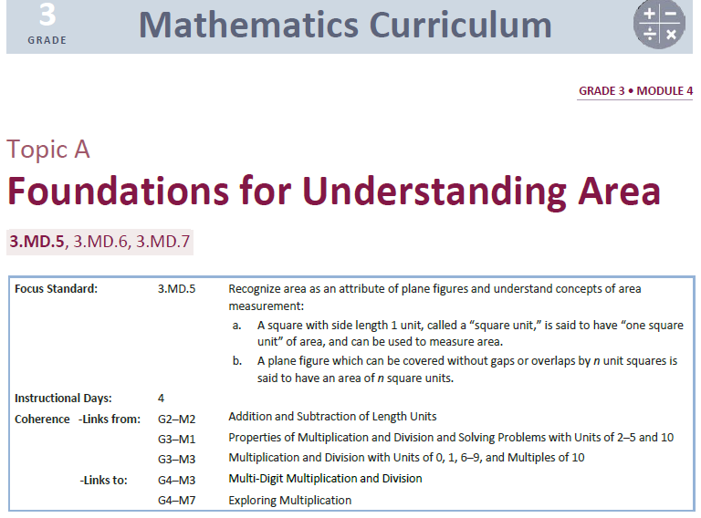

Slide 36
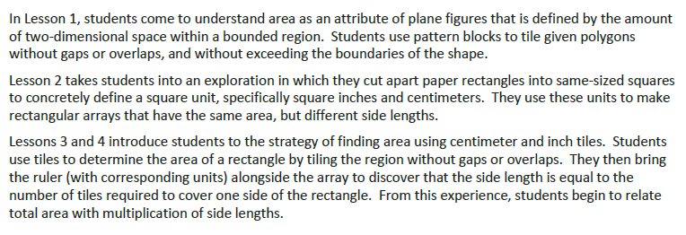
Topic Opener- Narrative

Slide 37
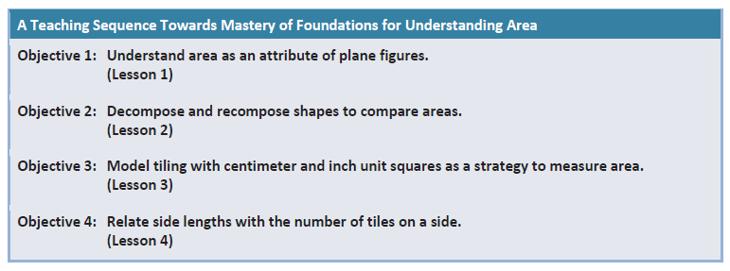
Topic Opener- Topic A’s Objectives

Slide 38
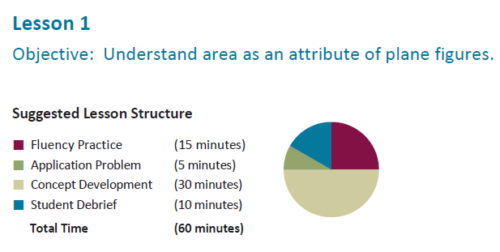
Lesson Structure

Slide 39
Math Publisher’s Criteria
Rigor: in major topics, pursue with equal intensity
    conceptual understanding
    procedural skill and fluency
    applications
http://corestandards.org/assets/Math_Publishers_Criteria_K-8_Summer%202012_FINAL.pdf
Notes:
Publisher’s Criteria- http://corestandards.org/assets/Math_Publishers_Criteria_K-8_Summer%202012_FINAL.pdf
This document outlines the expectations for materials that are aligned to the common core standards.

Slide 40

Fluency
Fluency is designed to promote automaticity by engaging students in practice in ways that get their adrenaline flowing.
Automaticity is critical so that students avoid using up too many of their attention resources with lower-level skills when they are addressing higher-level problems.
Set a timer and stop when your fluency time is up!
Fluency follows instruction!

Slide 41
Application Problems
RDW or Read, Draw, Write (a Number Sentence and a Statement)
Mathematicians and teachers suggest a simple process applicable to all grades:
1) Read.
2) Draw and Label.
3) Write a number sentence (equation).
4) Write a word sentence (statement).
Modeling with Interactive Questioning
Guided Practice
Independent Practice

Slide 42
Concept Development (10 min Problem Set)
Constitutes the major portion of instruction
Generally comprises at least 20 minutes of the total lesson time.
It is the primary lesson component, in which new learning is introduced.
Intentional sequencing of standards and topics within modules ensures that students have the requisite understanding to fully access new learning goals and integrate them into their developing schemas.
Lesson Dialogue serves as a vignette to help you see an example lesson- simple to complex, explanations, questions.

Slide 43
Problem Sets
Arranged simple to complex
Time Frame vs. Task Frame
Assign a balanced diet of questions so that a student who works slowly will get to do some of the problems on the back.
Keep focused on your standard.

Slide 44
Debrief
Essential Part of the Lesson Structure!
Students identify patterns and make connections
It’s an investment of time into helping students make connections, see patterns, and work thoughtfully.
The objective is discussed at this time.

Slide 45
Exit Ticket
Follows the debrief after the student have had an opportunity to share and hear classmates observations.
Provides a daily gauge of student understanding.

Slide 46
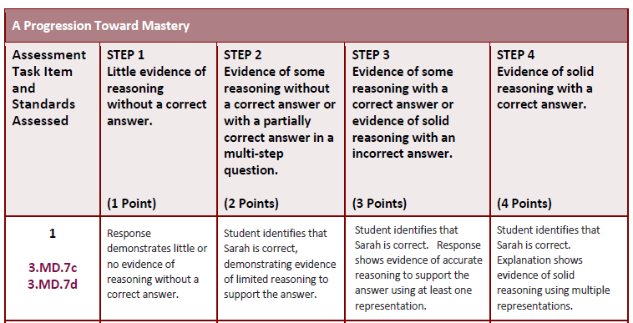
Assessments

Slide 47
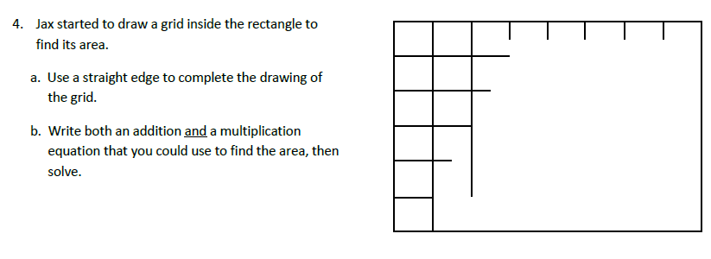
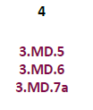
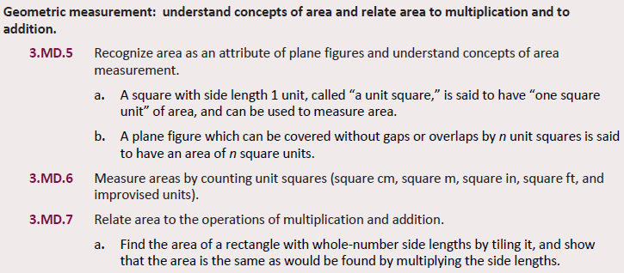

Slide 48
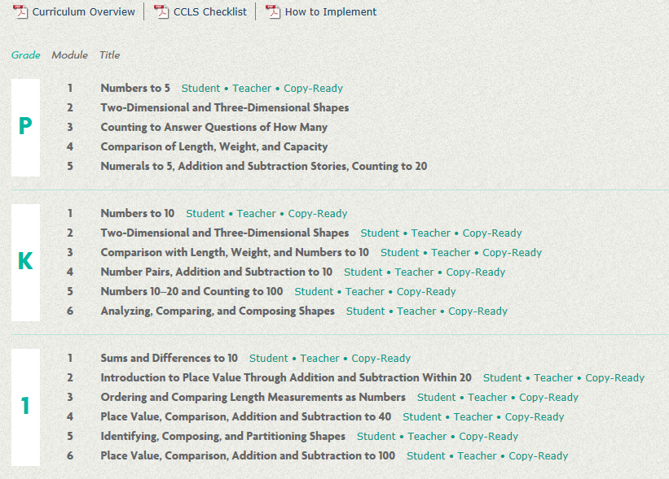
Accessing PDF’s of the Modules
http://commoncore.org/maps/math/module-pdfs

