Slide 1
GRADE 5 • MODULE 1
Topic A
Multiplicative Patterns on the Place Value Chart
5.NBT.1, 5.NBT.2, 5.MD.1

Slide 2
NYS Common Core Standards-Topic A
FOCUS STANDARDS
5.NBT.1 Recognize that in a multi-digit number, a digit in one place represents 10 times as much as it represents in the place to its right and 1/10 of what it represents in the place to its left.
5.NBT.2 Explain patterns in the number of zeros of the product when multiplying a number by powers of 10, and explain patterns in the placement of the decimal point when a decimal is multiplied or divided by a power of 10. Use whole number exponents to denote powers of 10.
5.MD.1 Convert among different-sized standard measurement units within a given measurement system (e.g., convert 5 cm to 0.05 m), and use these conversions in solving multi-step, real world problems.

Slide 3
Lesson 1
Objective: Reason concretely and pictorially using place value understanding to relate adjacent base ten units from millions to thousandths.

Slide 4
Fluency Practice (12 minutes)
Fluent means “fast and accurate.”
When you’re fluent, you flow. Fluent isn’t halting, stumbling, or reversing oneself.

Slide 5
A: Sprint: Multiply by 10 (8 minutes)
Sprint A- Do not turn your sprint over. You will have 60 seconds to do as many problems as you can. I do not expect you to finish all of them. Do as many as you can, your personal best.

Slide 6

A: Sprint: Multiply by 10 (8 minutes)
Take your mark.
Get set!!!
Think!!!
1:00
0:59
0:58
0:57
0:56
0:55
0:54
0:53
0:52
0:51
0:50
0:49
0:48
0:47
0:46
0:45
0:44
0:43
0:42
0:41
0:40
0:39
0:38
0:37
0:36
0:35
0:34
0:33
0:32
0:31
0:30
0:29
0:28
0:27
0:26
0:25
0:24
0:23
0:22
0:21
0:20
0:19
0:18
0:17
0:16
0:15
0:14
0:13
0:12
0:11
0:10
0:09
0:08
0:07
0:06
0:05
0:04
0:03
0:02
0:01
End

Slide 7
Rename the Units—Choral Response (2 minutes)
10 ones = _____ ten.
Say the number sentence filling in the blank.
10 ones = 1 ten.

Slide 8
Rename the Units—Choral Response (2 minutes)
20 ones = _____ ten.
Say the number sentence filling in the blank.
20 ones = 2 tens.

Slide 9
Rename the Units—Choral Response (2 minutes)
30 ones= _____ tens
Say the number sentence filling in the blank.
30 ones = 3 tens.

Slide 10
Rename the Units—Choral Response (2 minutes)
90 ones = ____ tens
Say the number sentence filling in the blank.
90 ones = 9 tens.

Slide 11
Rename the Units—Choral Response (2 minutes)
100 ones
Say the number sentence filling in the blank.
100 ones = 10 tens.

Slide 12
Rename the Units—Choral Response (2 minutes)
110 ones
Say the number sentence filling in the blank.
110 ones = 11 tens.

Slide 13
Rename the Units—Choral Response (2 minutes)
270 ones
Say the number sentence filling in the blank.
270 ones = 27 tens.

Slide 14
Rename the Units—Choral Response (2 minutes)
670 ones
Say the number sentence filling in the blank.
670 ones = 67 tens.

Slide 15
Rename the Units—Choral Response (2 minutes)
830 ones
Say the number sentence filling in the blank.
830 ones = 83 tens.

Slide 16
Decimal Place Value (2 minutes)
Please take out your personal white boards

Slide 17
Decimal Place Value (2 minutes)
3
0
There are 3 tens and how many ones?
There are zero ones
Write 3 tens = 30 ones
3 tens
Draw 3 ten disks in the tens column.
How many tens do you see?

Slide 18
Decimal Place Value (2 minutes)
0 . 4
0.4
Write 4 tenths = ________.
Draw four 1 tenth disks on your chart.

Slide 19
Decimal Place Value (2 minutes)
0 . 0 3
0.03
Write 3 hundredths = ________.
Draw three 1 hundredths disks on your chart.

Slide 20
Decimal Place Value (2 minutes)
0 . 4
0 .
0 . 4 3
0.43
Write 43 hundredths = ________.
How can we place our disks on the chart?

Slide 21
Decimal Place Value (2 minutes)
7 . 3
7 . 3 5
7 .
7.35
Write 7 ones 35 hundredths = ________.
How can we place our disks on the chart?

Slide 22
Decimal Place Value (2 minutes)
6 2 . 0 4
6 2 .
6 .
62.04
Write 6 tens 2 ones 4 hundredths = ________.
How can we place our disks on the chart?

Slide 23
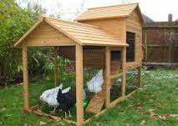
Application Problem (8 minutes):
Farmer Jim keeps 12 hens in every coop. If Farmer Jim has 20 coops, how many hens does he have in all?
Farmer Jim has 240 hens

Slide 24
Application Problem (8 minutes):
If every hen lays 9 eggs on Monday, how many eggs will Farmer Jim collect on Monday? Explain your reasoning using words, numbers, or pictures.
200
40
9
1800
360
Farmer Jim will collect 2,160 eggs on Monday.

Slide 25
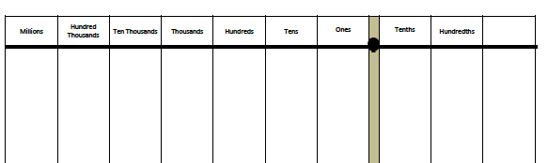
Concept Development (30 min.)
Show 1 million using disks on your chart.

Slide 26
Concept Development (30 min.)
How can we show 1 million using hundred thousands?
How many hundred thousands = 1 million?
Talk with your elbow partner.

Slide 27
Concept Development (30 min.)
10
1 million is the same as __ hundred thousands.

Slide 28
Concept Development (30 min.)
What would happen if I divide 10 hundred thousands
by 10?
Talk with your elbow partner about how to find the quotient.

Slide 29
Concept Development (30 min.)
10 hundred thousands 10 =
1 hundred thousand
1 million is the same as 10 hundred thousands

Slide 30
Concept Development (30 min.)
1
1 million 10 =
1 hundred thousand
1 hundred thousand is 1/10 as large as 1 million

Slide 31
Concept Development (30 min.)
1
Put 1 ten thousand disk on your chart.
What is the result if we divide 1 ten thousand by 10?
1 ten thousand 10 = 1 thousand
1 thousand is 1/10 as large as 1 ten thousand

Slide 32
Concept Development (30 min.)
1
1
1 hundred
1 thousand 10 =
1 hundred is 1/10 as large as 1 thousand

Slide 33
Concept Development (30 min.)
1
1
1 ten
1 hundred 10 =
1 ten is 1/10 as large as 1 hundred

Slide 34
Concept Development (30 min.)
1
1
1 one
1 ten 10 =
1 one is 1/10 as large as 1 ten

Slide 35
Concept Development (30 min.)
1
1
1 tenth
1 one 10 =
1 tenth is 1/10 as large as 1 one

Slide 36
Concept Development (30 min.)
1
1
1 hundredth
1 tenth 10 =
1 hundredth is 1/10 as large as 1 tenth

Slide 37
Concept Development (30 min.)
What patterns do you notice in the way the units are named in our place value system?
The ones place is the middle.
Highlight the ones place with your yellow highlighter.
There are tens on the left
and tenths on the right.
There are hundreds on the left
and hundredths on the right.

Slide 38
Concept Development (30 min.)
Thousandths
Using this pattern, can you predict what the name of the unit that is to the right of the hundredths place will be? Hint- it is 1/10 as large as hundredths.
Write thousandths in the appropriate place on your chart

Slide 39
Concept Development (30 min.)
Thousandths
=
1
Thinking about the pattern that we’ve seen with other adjacent places, talk with your partner and predict how we might show 1 hundredth using thousandths disks on your chart.
1 hundredth= ___ thousandths
10

Slide 40
Concept Development (30 min.)
Thousandths
1
1
1 thousandths
1 hundredth =
1 thousandths is 1/10 as large as 1 hundredths

Slide 41
Decimal Place Value (2 minutes)
Thousandths
0 . 4
X 10
4
Draw number disks to represent 4 tenths on your place value chart.
4
Work with your partner to find the value of 10 x 0.4= _____. Show the results at the bottom of your place value chart.

Slide 42
Decimal Place Value (2 minutes)
Thousandths
0 . 4
X 10
4
10 x 0.4 = 4
Why does the digit move one place to the left?
It is 10 times as large, it has to be bundled for the next larger unit.

Slide 43
Decimal Place Value (2 minutes)
Thousandths
0 . 0 4
X 10
0 . 4
0.4
Work with your partner to find the value of 10 x 0.04= _____. Show the results at the bottom of your place value chart.

Slide 44
Decimal Place Value (2 minutes)
Thousandths
0.04
Work with your partner to find the value of 10 x 0.004 = _____.
I need a volunteer to show the work on the board.

Slide 45
Decimal Place Value (2 minutes)
Thousandths
Work with your partner to find the value of 0.03 x 10 = _____.
0.3
I need a volunteer to show the work on the board.

Slide 46
Decimal Place Value (2 minutes)
Thousandths
Work with your partner to find the value of 0.003 x 100 = ____.
0.3
I need a volunteer to show the work on the board.

Slide 47
Decimal Place Value (2 minutes)
Thousandths
Work with your partner to find the value of
0.6
I need a volunteer to show the work on the board.

Slide 48
Decimal Place Value (2 minutes)
Thousandths
Work with your partner to find the value of
0.06
I need a volunteer to show the work on the board.

Slide 49
Decimal Place Value (2 minutes)
Thousandths
Work with your partner to find the value of
0.007
I need a volunteer to show the work on the board.

Slide 50
Decimal Place Value (2 minutes)
Thousandths
Work with your partner to find the value of
0.005
I need a volunteer to show the work on the board.

Slide 51
Decimal Place Value (2 minutes)
Thousandths
Work with your partner to find the value of
0.0005
I need a volunteer to show the work on the board.

Slide 52
Decimal Place Value (2 minutes)
Thousandths
Work with your partner to find the value of
24.3
I need a volunteer to show the work on the board.

Slide 53
Decimal Place Value (2 minutes)
Thousandths
Work with your partner to find the value of
2430
I need a volunteer to show the work on the board.

Slide 54
Decimal Place Value (2 minutes)
Thousandths
Work with your partner to find the value of
74.5
I need a volunteer to show the work on the board.

Slide 55
Decimal Place Value (2 minutes)
Thousandths
Work with your partner to find the value of
7.45
I need a volunteer to show the work on the board.

Slide 56
Problem Set 10 min.
Are you ready for some practice?

Slide 57
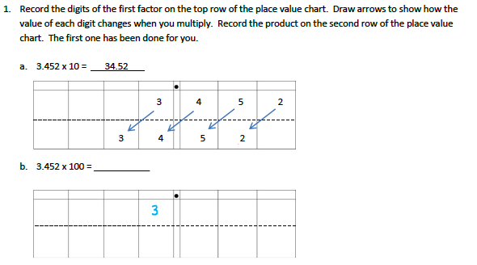

Slide 58
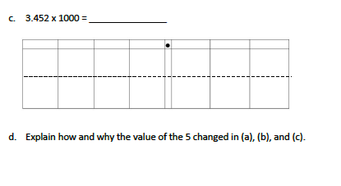

Slide 59
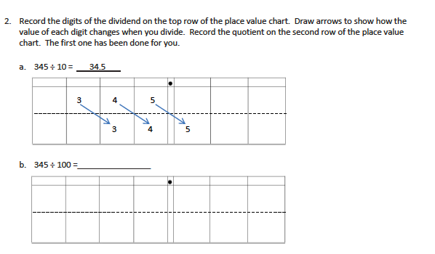

Slide 60
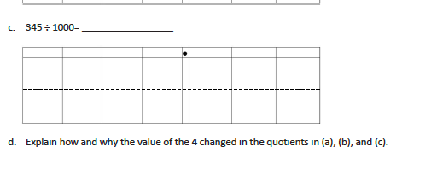

Slide 61
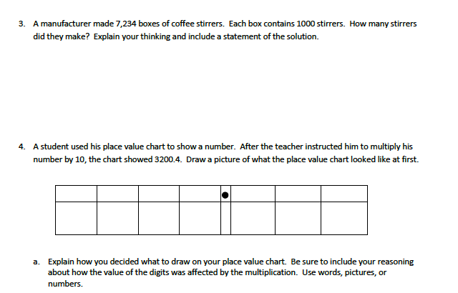

Slide 62
5. A microscope has a setting that magnifies an object so that it appears 100 times as large when viewed through the eyepiece. If a tiny insect is 0.095 cm long, how long will the insect appear in centimeters through the microscope? Explain how you know.

Slide 63
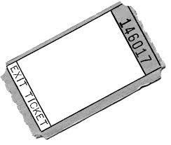
Time for your Exit ticket.
These will be graded daily with a final score given at the end of the week.
Take your time and think.
Turn in your exit ticket to the Math bin.
Take your homework from the front table.

