Slide 1
A Story of Units
Grade 1 – Module 3
Notes:
NOTE THAT THIS SESSION IS DESIGNED TO BE 80 MINUTES IN LENGTH.
Welcome! In this module focus session, we will examine Grade 1 – Module 3.
TIME ALLOTTED FOR THIS SLIDE:
0 minutes
MATERIALS NEEDED:
X

Slide 2
Session Objectives
Examination of the development of mathematical understanding across the module using a focus on Concept Development within the lessons.
Introduction to mathematical models and instructional strategies to support implementation of A Story of Units.
Notes:
Our objectives for this session are to:
Examination of the development of mathematical understanding across the module using a focus on Concept Development within the lessons.
Introduction to mathematical models and instructional strategies to support implementation of A Story of Units.
TIME ALLOTTED FOR THIS SLIDE:
1 minute
MATERIALS NEEDED:
X

Slide 3
Agenda
Introduction to the Module
Concept Development
Module Review
Notes:
We will begin by recognizing the location of the module within the Grade 1 curriculum and then experience some of the math of the module, leading you through the teaching sequence, one concept at a time. We will then explore the module overview, identifying what is and what is not included in the scope of the module. Along the way, we’ll also examine the other lesson components and how they function in collaboration with the concept development. Finally, we’ll take a look back at the module, reflecting on all the parts as one cohesive whole.
Let’s get started by looking at the Story of Units curriculum map.
TIME ALLOTTED FOR THIS SLIDE:
1 minutes
MATERIALS NEEDED:
X

Slide 4
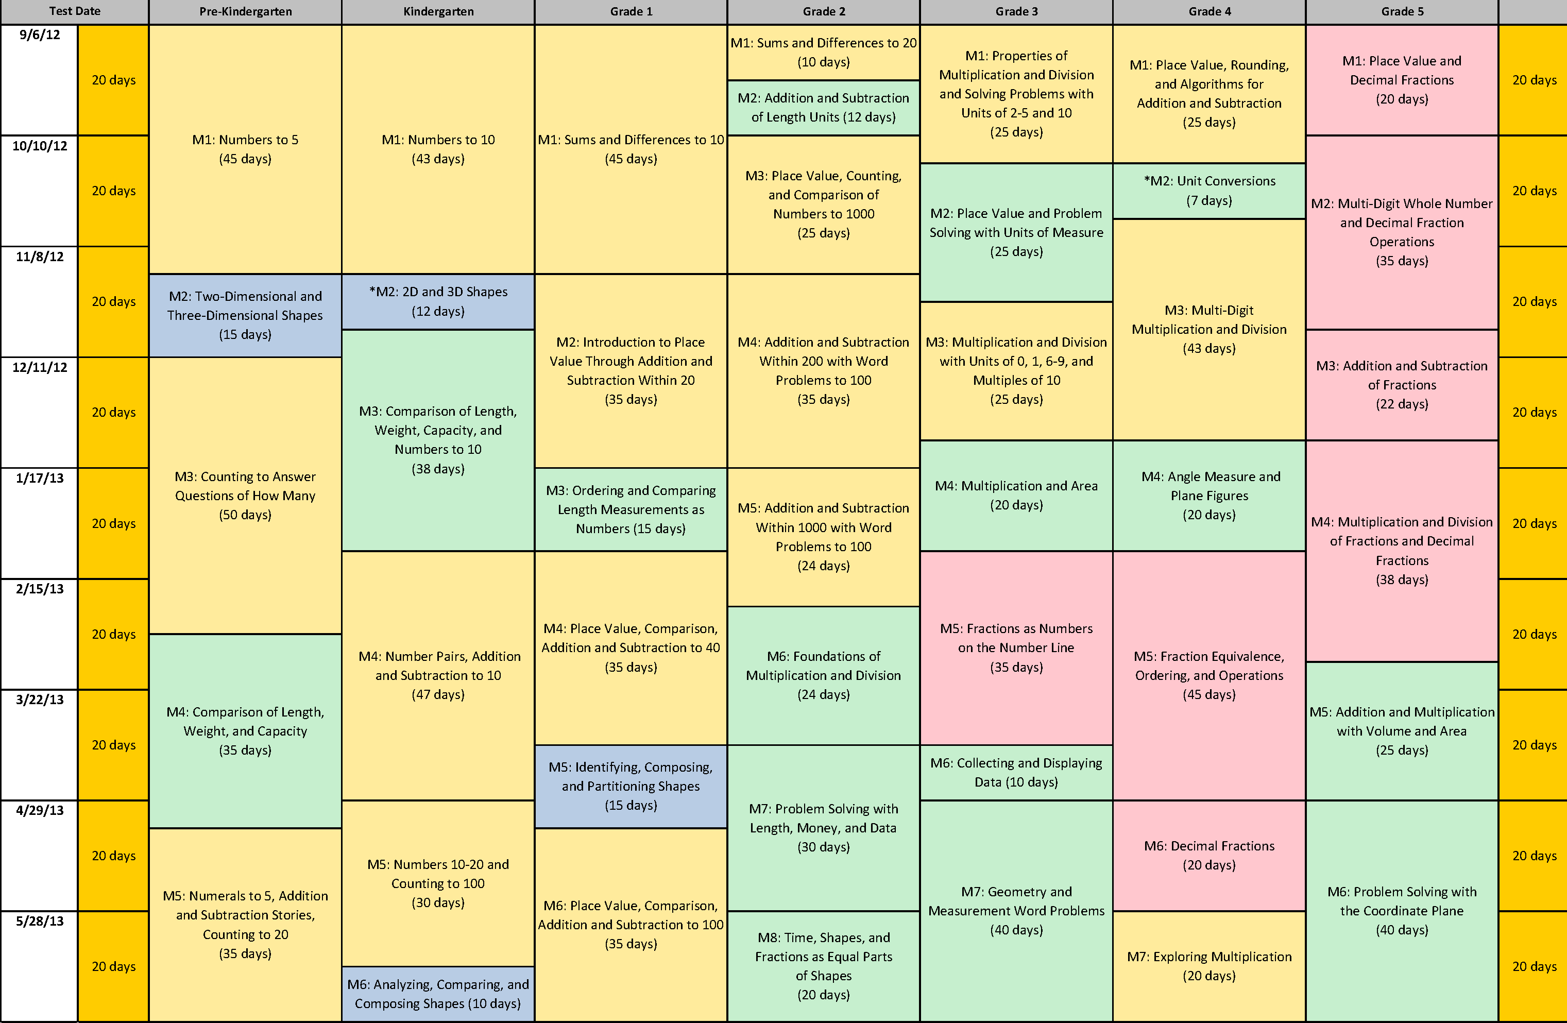
Grade 1’s Module 3: Ordering and Comparing Length Measurements as Numbers
Notes:
The third module in Grade 1 is Ordering and Comparing Length Measurements as Numbers. The module includes 13 lessons and is allotted 15 instructional days.
TIME ALLOTTED FOR THIS SLIDE:
1 minutes
MATERIALS NEEDED:
X

Slide 5
Agenda
Introduction to the Module
Concept Development
Module Review
Notes:
TIME ALLOTTED FOR THIS SLIDE:
0 minutes
MATERIALS NEEDED:
X

Slide 6
Which is longer? Which is shorter?
Lesson Objective: Compare length directly and consider importance of aligning endpoints.
Notes:
Taken from Lesson 1, present a marker and an unsharpened pencil from behind a folder, intentionally holding the marker so that it appears longer than the pencil. Ask participants which is longer? Move the folder so that participants can see both objects fully.
What do we need to do to accurately compare these objects? (Align their endpoint. Write this on chart paper with a title, “Rules for Measuring Accurately.”)
Give participants 1 minute to try to fool their table mates in a similar way.
Ask participants:
What is the important learning?
How does this build upon or review the measurement work from Grade K?
(Discuss for 2 minutes.)
TIME ALLOTTED FOR THIS SLIDE:
5 minutes
MATERIALS NEEDED:
Folder
Jumbo dry eras marker
Unsharpened pencil

Slide 7
How can you compare length without putting objects side by side?
Lesson Objective: Compare length using indirect comparison by finding objects longer than, shorter than, and equal in length to that of a string.
Notes:
Taken from Lesson 2, ask how we can tell if the show is longer than the chart paper without taking the teacher’s shoe off of her foot. What materials can be used to help compare the shoe and the paper? After measuring the paper with a piece of string the size of the shoe, compare the same string with the length of an unsharpened pencil. Using the string to compare, participants find that the shoe is shorter than the paper and the unsharpened pencil is shorter than the paper.
Ask participants:
What is the important learning?
How does this build upon or review the measurement work from Grade K?
(Discuss for 2 minutes.)
TIME ALLOTTED FOR THIS SLIDE:
4 minutes
MATERIALS NEEDED:
String
Chart paper hanging relatively high on the wall

Slide 8
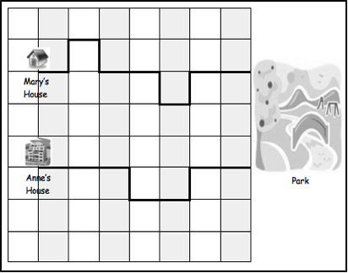
How can you compare distances?
Mary’s and Anne’s paths on the City Blocks grid
Lesson Objective: Order three lengths
using indirect comparison.
Notes:
Taken from Lesson 3,
Ask participants:
What is the important learning?
How does this build upon or review the measurement work from Grade K?
(Discuss for 2 minutes.)
TIME ALLOTTED FOR THIS SLIDE:
5 minutes
MATERIALS NEEDED:
Lesson 3 City Blocks Grid
Masking or painters’ tape for floor

Slide 9
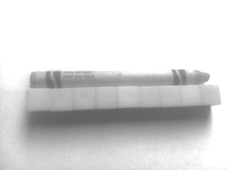
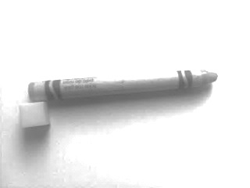
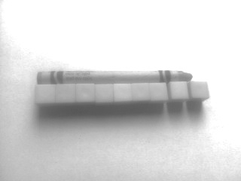
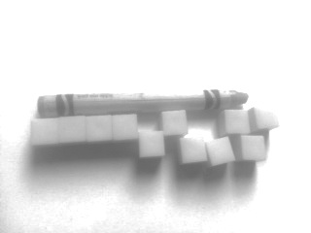
Exactly how long IS it?
Lesson Objective: Express the length of an object using centimeter cubes as length units to measure with no gaps or overlaps.
Notes:
Taken from Lesson 4, describe the length of an new crayon using centimeter cubes. What do we need to do to be sure we have an accurate measurement?
What do we need to do to accurately compare these objects? (Start at the endpoint. Put the cubes next to each other so that there are no gaps. Keep the cubes touching in a straight row so that there are no overlaps. Add to the Rules for Measuring Accurately chart.)
Ask participants:
What is the important learning?
How does this build upon or review the measurement work from Grade K?
(Discuss for 2 minutes.)
TIME ALLOTTED FOR THIS SLIDE:
5 minutes
MATERIALS NEEDED:
X

Slide 10
What is similar between a ruler and centimeter cubes?
Lesson Objective: Rename and measure with centimeter cubes, using their standard unit name of centimeters.
Notes:
Taken from Lesson 5, ask the participants to put the centimeter cubes up next to the ruler. What do they notice?
Ask participants:
What is the important learning?
How does this build upon or review the measurement work from Grade K?
(Discuss for 2 minutes.)
TIME ALLOTTED FOR THIS SLIDE:
4 minutes
MATERIALS NEEDED:
Rulers, taped to expose only centimeters

Slide 11
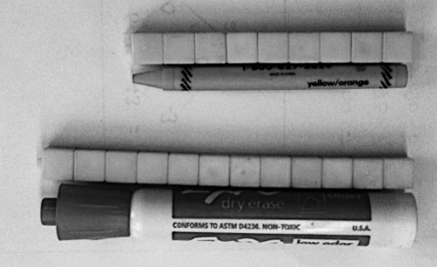
How can we compare even more precisely?
Lesson Objective: Order, measure, and compare the length of objects before and after measuring with centimeter cubes, solving compare with difference unknown word problems
.
Notes:
Taken from Lesson 6, invite participants to measure a crayon and a marker at their table. How can we compare this crayon and marker even more precisely?
Ask participants:
What is the important learning?
How does this build upon or review the measurement work from Grade K?
What kind of word problem is being set up here? What strategies or techniques might students use to solve? (This is the first introduction students have to comparison word problems. It is intentionally introduced during this module so that students have experiences with concrete materials that can be manipulated as they recognize strategies for solving.)
(Discuss for 2 minutes.)
TIME ALLOTTED FOR THIS SLIDE:
5 minutes
MATERIALS NEEDED:
New crayons
Jumbo dry erase markers
Centimeter cubes

Slide 12
What can we learn from the paper clip problem?
Lesson Objective: Measure the same objects from Topic B with different non-standard units simultaneously to see the need to measure with a consistent unit.
Notes:
Taken from Lesson 7, ask participants what is problematic in the image shown.
What do we need to do to accurately compare these objects? (Use the same kind of paper clip throughout. Add Use the same exact length unit to measure to the Rules for Measuring Accurately chart.)
Ask participants:
What is the important learning?
How does this build upon or review the measurement work from Grade K?
(Discuss for 2 minutes.)
If it comes up, share information from Progressions document on geometric measurement as written below. Otherwise, discuss this point during Module Overview review.
“Many curricula or other instructional guides advise a sequence of instruction in which students compare lengths, measure with nonstandard units (e.g., paper clips), incorporate the use of manipulative standard units (e.g., inch cubes), and measure with a ruler. This approach is probably intended to help students see the need for standardization. However, the use of a variety of different length units, before students understand the concepts, procedures, and usefulness of measurement , may actually deter students’ development. Instead, students might learn to measure correctly with standard units, and even learn to use rulers, before they can successfully use nonstandard units and understand relationships between
different units of measurement. To realize that arbitrary (and especially mixed-size) units result in the same length being described by different numbers, a student must reconcile the varying lengths and numbers of arbitrary units. Emphasizing nonstandard units too early may defeat the purpose it is intended to achieve. Early use of many nonstandard units may actually interfere with students’ development of basic measurement concepts required to understand the need for standard units. In contrast, using manipulative standard units, or even standard rulers, is less demanding and appears to be a more interesting and meaningful real-world activity
for young students.” p.9
TIME ALLOTTED FOR THIS SLIDE:
4 minutes
MATERIALS NEEDED:
Small paper clips
Large paper clips
Unsharpened pencils

Slide 13
What is important when communicating about measurement?
Lesson Objective: Understand the need to use the same units when comparing measurements with others.
Notes:
Taken from Lesson 8, have each table measure a marker, an unsharpened pencil, and a jumbo craft stick with the bag of measurement tools provided. (Unknowingly, each table has a different length unit to use, as listed below:
Table 1: small paper clips
Table 2: large paper clips
Table 3: centimeter cubes
Table 4: toothpicks
Table 5: bits of string
Begin listing each table’s measurements on a chart.
What's happening here?
What should we add to our chart for what to do so we can communicate our measurements with others? (On Rules for Measuring Accurately chart, add a section below that says, “When talking about measurements with others, always name your length unit. It’s best to use the same length unit as the others so you can compare.)
Ask participants:
What is the important learning?
How does this build upon or review the measurement work from Grade K?
(Discuss for 2 minutes.)
TIME ALLOTTED FOR THIS SLIDE:
5 minutes
MATERIALS NEEDED:
Small paper clips
Large paper clips
Centimeter cubes
Toothpicks
Bits of equal sized string
Jumbo dry erase markers, jumbo craft stick, unsharpened pencils
Lesson 8 Problem Set p.1

Slide 14
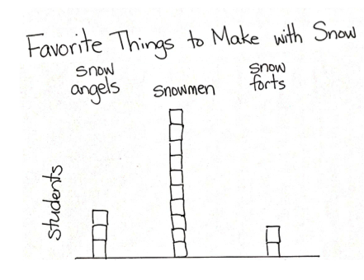
Data: Collecting and Interpreting Information
Notes:
The other topic in this module is data interpretation. Students will collect, organize, and sort data, along with asking and answering questions about data from visual tables such as those shown on the slide.
TIME ALLOTTED FOR THIS SLIDE:
2 minutes
MATERIALS NEEDED:
X

Slide 15
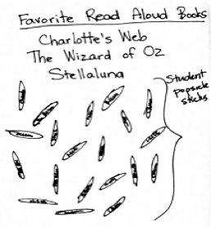
Which of these books is your favorite?
Chart 1 with popsicle sticks placed by students.
Lesson Objective: Collect, sort, and organize data, then ask and answer questions about the number of data points.
Notes:
Ask participants to share their favorite first grade read-aloud books. Choose three books from among those shared and list them on chart paper.
On the popsicle stick, have participants write their favorite book from among the three listed on the chart paper. (While participants are writing, add three book choices to the chart used for the next slide.)
Participants bring up their popsicle sticks and place on the chart paper.
Can we easily see how many people liked each book? What are some of the ways we have used in class to easily organize materials so we can count them quickly?
Today, we’ll use a new method of showing 5-groups, called tally marks.
TIME ALLOTTED FOR THIS SLIDE:
4 minutes
MATERIALS NEEDED:
Popsicle sticks
Chart paper

Slide 16
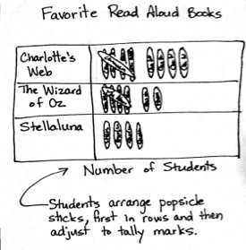
Which of these books is your favorite?
Chart 2 with popsicle sticks arranged as tallies.
Lesson Objective: Collect, sort, and organize data, then ask and answer questions about the number of data points.
Notes:
Lay new chart next to the previous chart, and move over popsicle sticks, creating tally marks with the sticks.
Ask participants:
What is the important learning?
How does this build upon or review the measurement work from Grade K?
(Discuss for 2 minutes.)
TIME ALLOTTED FOR THIS SLIDE:
4 minutes
MATERIALS NEEDED:
Chart paper
Popsicle sticks from previous slide

Slide 17
Asking and Answering Questions about Data
Notes:
As students move on to collect and organize data and to ask and answer questions from their collections, what do you foresee as important learning?
How does this build upon or review the mathematical work from Grade K?
(Discuss for 2 minutes.)
TIME ALLOTTED FOR THIS SLIDE:
4 minutes
MATERIALS NEEDED:
X

Slide 18
Agenda
Introduction to the Module
Concept Development
Module Review
Notes:
Having experienced the mathematics within the module, let’s now take a look at the Module Overview to see how this learning is organized. We will also reflect on what mathematical ideas about measurement or data were not shared as a part of this module.
TIME ALLOTTED FOR THIS SLIDE:
1 minutes
MATERIALS NEEDED:
X

Slide 19
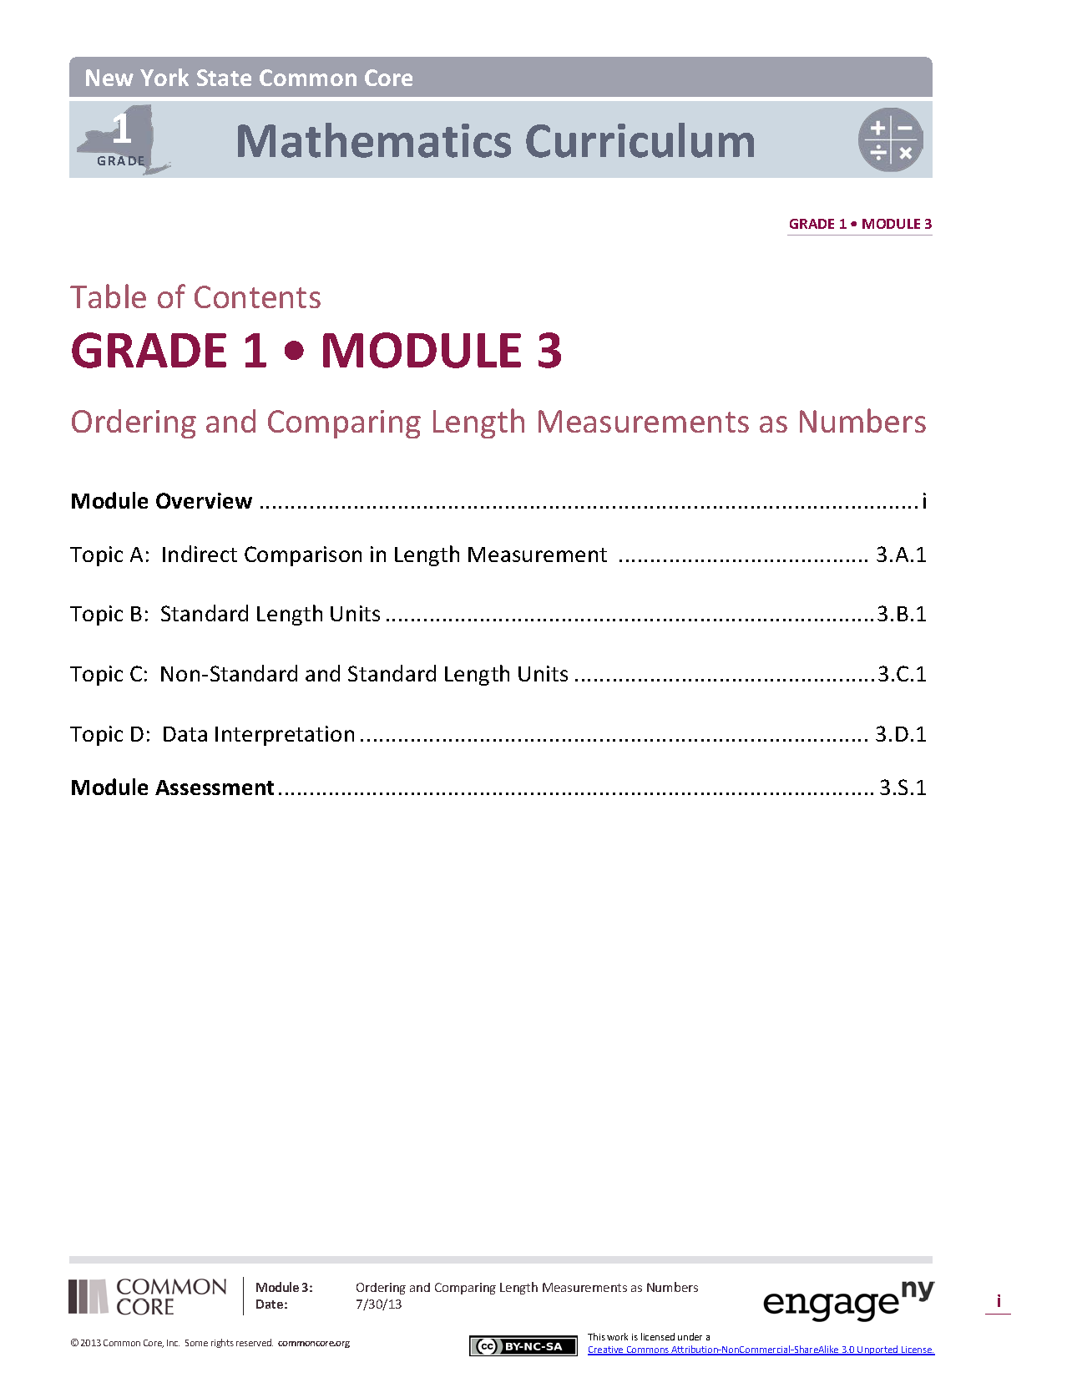
Module Overview
Read the narrative.
How is the module organized?
What skills or strategies have you previously taught that are not a part of the mathematical work of the module?
Notes:
Now we will take some time to read the Module Overview for Module 3. You will read about these learning we just shared in the context of the entirety of the module. As you read, notice the organization of the lessons and how each lesson is connected within the 4 overarching topics. Notice not only what is being taught in the module, but also what is not being taught. The Common Core’s shift in Focus means that learning around measurement is limited to key concepts for Grade 1.
Provide 8 minutes to read.
TIME ALLOTTED FOR THIS SLIDE:
10 minutes
MATERIALS NEEDED:
Module Overview

Slide 20
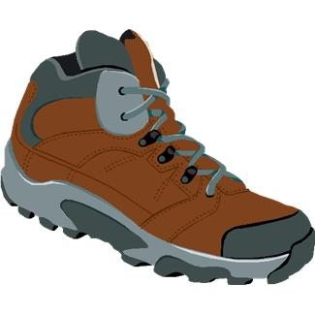
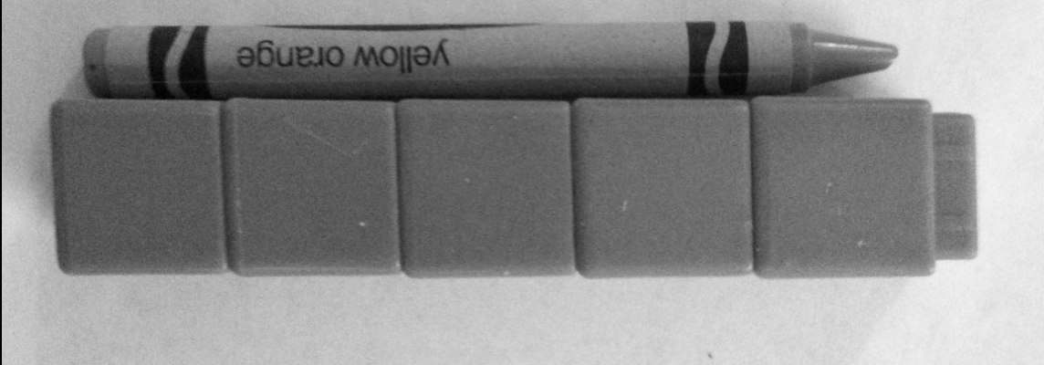
Module Overview by Topic
Topic A Topic B Topic C
Topic D
Notes:
How is the module organized?
What skills or strategies have you previously taught that are not a part of the mathematical work of the module?
Discuss questions for approximately 5 minutes.
This slide provides a visual reference for the 4 topics in the module.
If necessary, each topic is summarized below:
Topic A focuses on transitivity, where two objects are compared using a third object (indirect comparison). For instance, a string is compared with a shoe and a shelf to fine that the shoe is longer than the shelf.
In Topic B, students are introduced to the standard measurement of centimeters through the use of centimeter cubes to measure. They learn the key rules of accurate measurements, such as starting and ending at the endpoints, and having no gaps or overlaps between the pieces being used to measure. Students also begin to solve comparison word problems by concretely comparing the number of centimeter cubes used to measure different length objects.
During Topic C, students explore both standard and non-standard units of measure, and find that it is easier to communicate when everyone is using the same length units.
The module culminates with data interpretation, where students ask and answer questions about a set of data.
TIME ALLOTTED FOR THIS SLIDE:
5 minutes
MATERIALS NEEDED:
X

Slide 21
Agenda
Introduction to the Module
Concept Development
Module Review
Notes:
TIME ALLOTTED FOR THIS SLIDE:
0 minutes
MATERIALS NEEDED:
X

Slide 22
Biggest Takeaway
Turn and Talk:
What questions were answered for you?
What new questions have surfaced?
Notes:
Take two minutes to turn and talk with others at your table. During this session, what information was particularly helpful and/or insightful? What new questions do you have?
Allow 2 minutes for participants to turn and talk. Bring the group to order and advance to the next slide.
TIME ALLOTTED FOR THIS SLIDE:
3 minutes
MATERIALS NEEDED:
X

Slide 23
Key Points
Module 3 focuses on length measurement and data interpretation.
Along with basic procedures for each, the module also introduces comparison word problems through concrete applications.
The student debrief can be the critical moment for students in solidifying their understanding of the day’s lesson objective.
Application Problems and Fluency Practice continue to be an essential part of the learning.
Notes:
Let’s review key points from our examination of these lessons:
The student debrief can be the critical moment for students in solidifying their understanding of the day’s lesson objective. By revisiting the strategies, tools, and math terms from the lesson through specific examples of students’ work from the problem sets and application problems, they can utilize their own concrete examples as avenues for understanding.
TIME ALLOTTED FOR THIS SLIDE:
4 minutes
MATERIALS NEEDED:
X

